Slide 1
ANALYSIS, THERMAL, FARSIGHT AVIONICS MODULE
ITEM NUMBER: CM-02650
REV: | DESCRIPTION: | DATE: | APPROVED:
1
2
X | *Add additional rows if required | XX/XX/XXXX | X. XXXX
CM-01354_TEMPLATE, ENGINEERING, POWERPOINT, DETAILED_rev1 REV DATE: 01-11-2024

Slide 2
Overview
The Farsight Avionics Module (CM-02616) design was iterated collaboratively with input from the Mechanical, Thermal, and Structural teams
Thermal model Farsight_Avionics_Module_CM-02616_V17.dwg aligns with Version 17 of the CAD model
Key component details (heat loads, junction resistances, min/max temperatures) summarized here: THERMAL_INFO_DUMP
5°C thermal uncertainty margin is held for junction temperatures
Total nominal power dissipation of the module is 13 W
Hot case analysis performed for a 60°C mounting panel shows that the module can operate up to a 60°C mounting interface

Slide 3
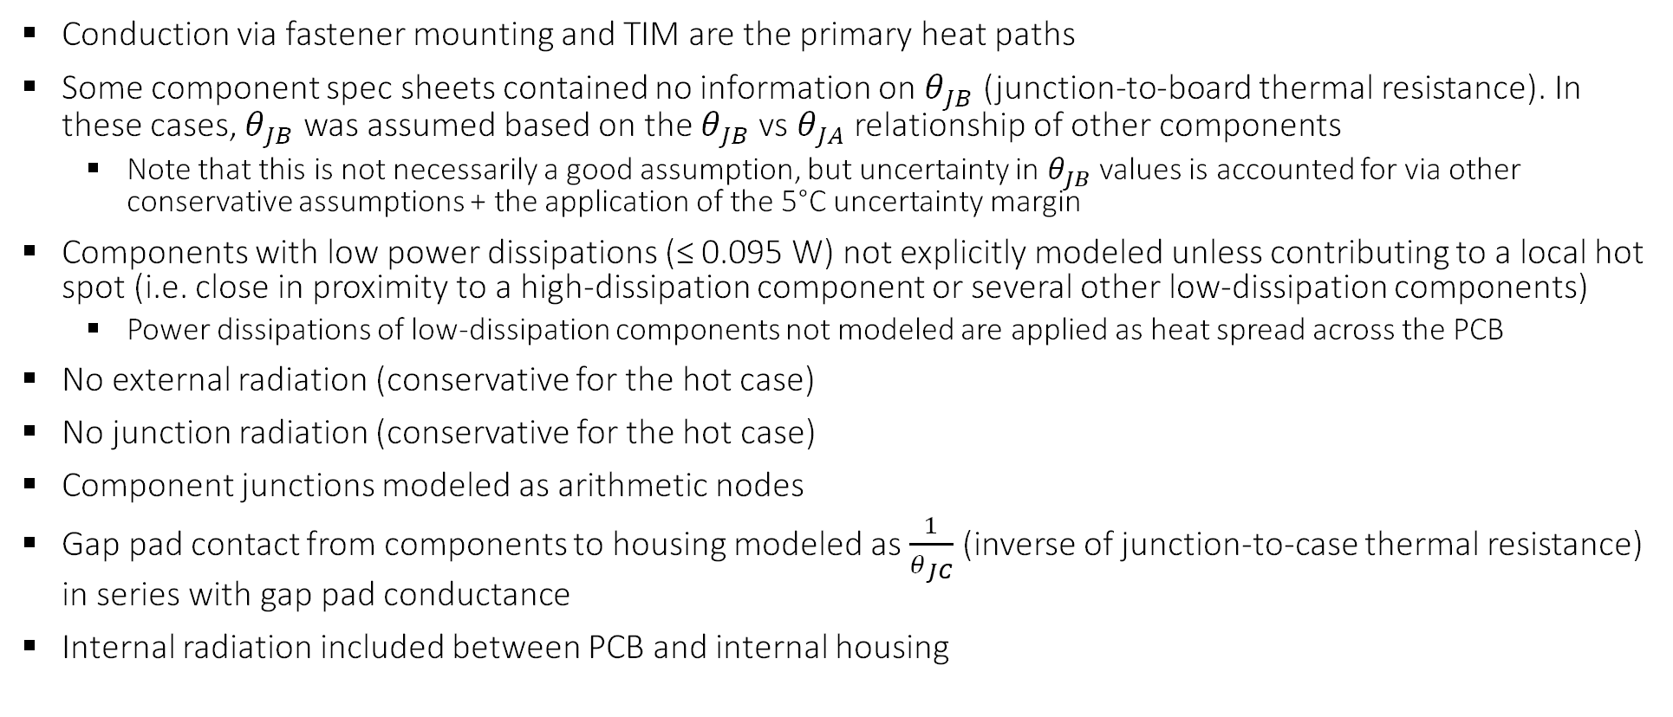
Assumptions
Conduction via fastener mounting and TIM are the primary heat paths
Some component spec sheets contained no information on $θ_{JB}$ (junction-to-board thermal resistance). In these cases, $θ_{JB}$ was assumed based on the $θ_{JB}$vs $θ_{JA}$ relationship of other components
  Note that this is not necessarily a good assumption, but uncertainty in $θ_{JB}$ values is accounted for via other conservative assumptions + the application of the 5°C uncertainty margin
Components with low power dissipations (≤ 0.095 W) not explicitly modeled unless contributing to a local hot spot (i.e. close in proximity to a high-dissipation component or several other low-dissipation components)
  Power dissipations of low-dissipation components not modeled are applied as heat spread across the PCB
No external radiation (conservative for the hot case)
No junction radiation (conservative for the hot case)
Component junctions modeled as arithmetic nodes
Gap pad contact from components to housing modeled as $\frac{1}{θ_{JC}}$ (inverse of junction-to-case thermal resistance) in series with gap pad conductance
Internal radiation included between PCB and internal housing

Slide 4
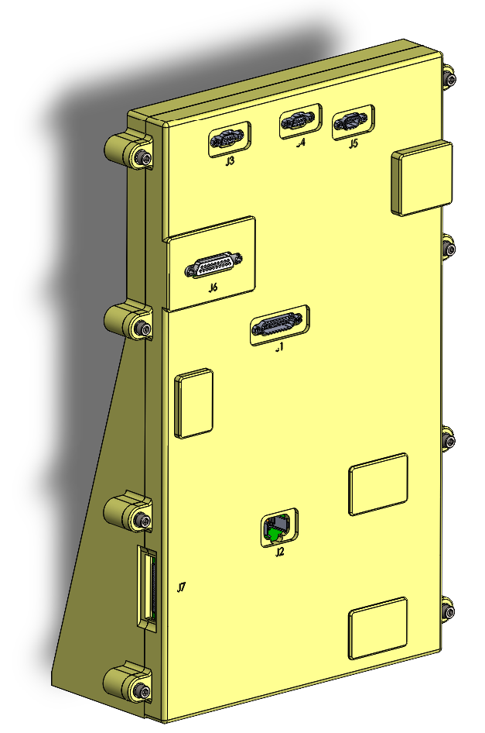
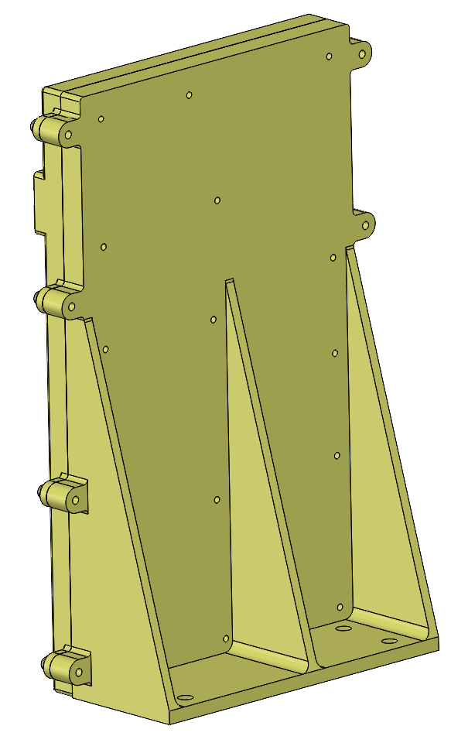
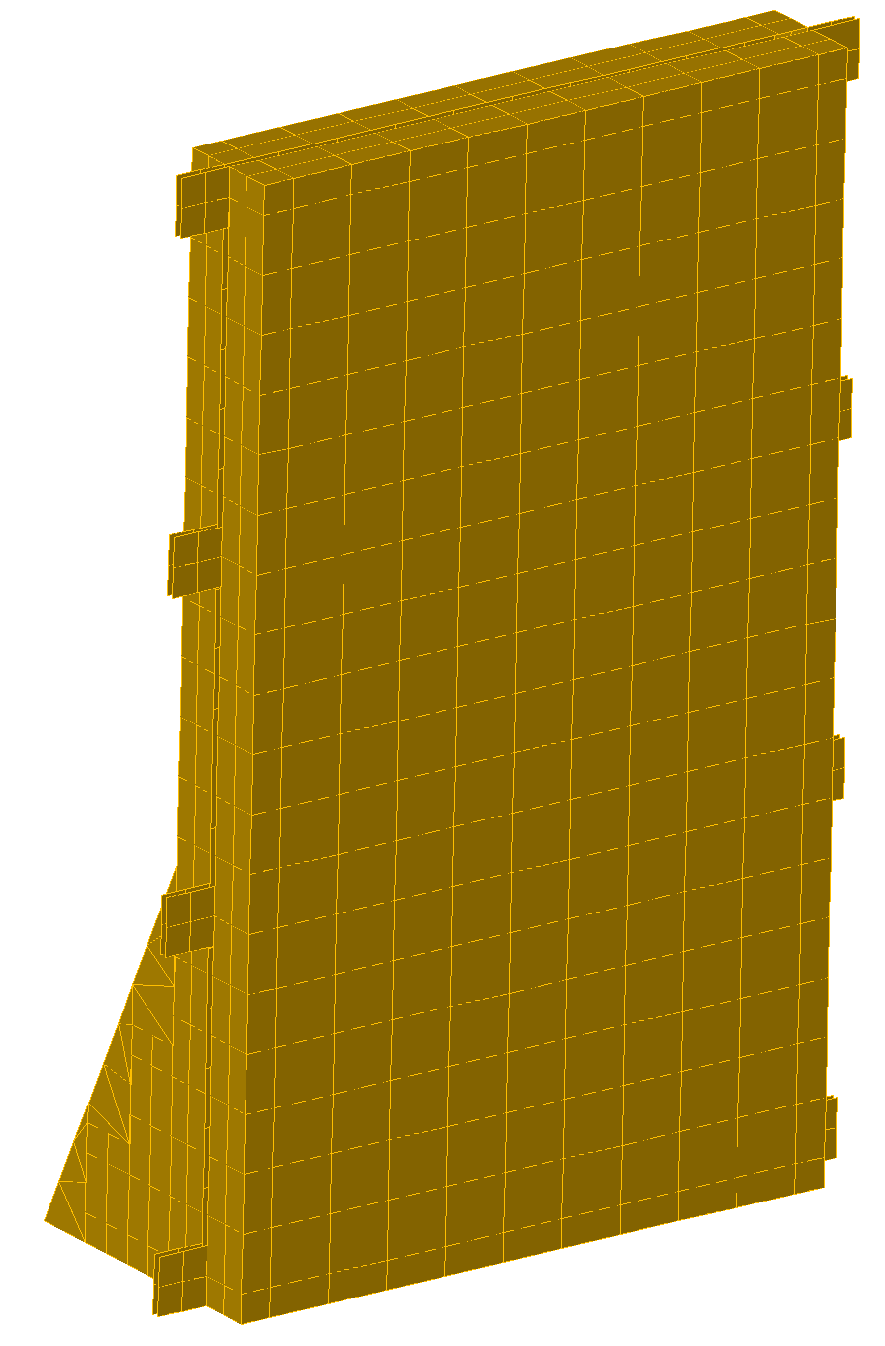
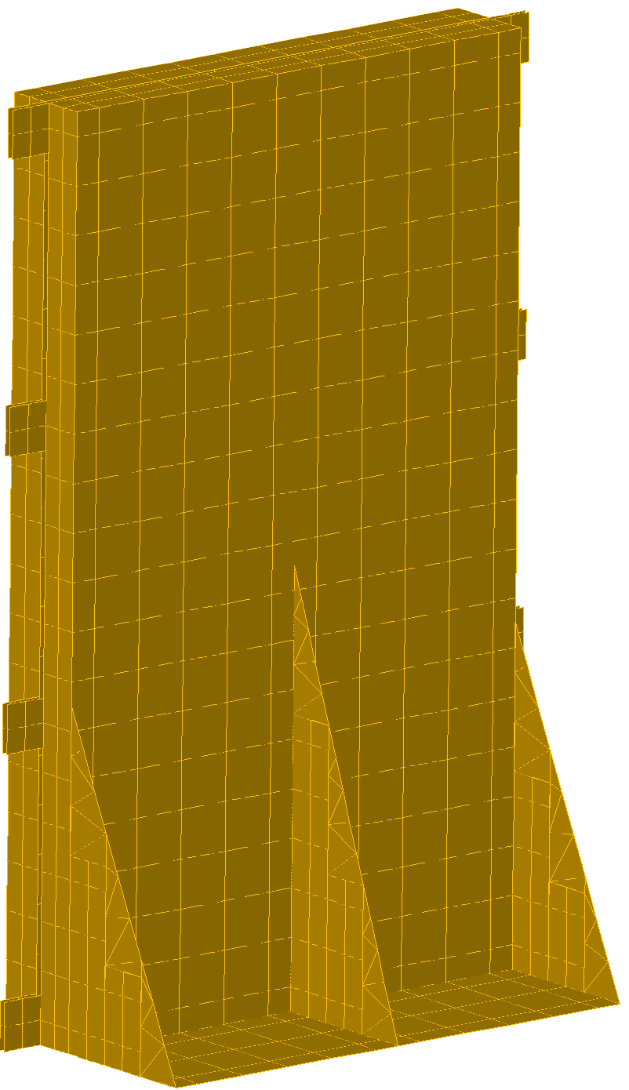
Thermal Model vs CAD
Density multipliers utilized to match Thermal Desktop mass to CAD
  Top Housing: 0.933 → mass of 742.70 g = CAD mass
  Bottom Housing: 1.08 → mass of 971.80 g = CAD mass
  PCB (board): 0.293 → mass of 88.82 g = CAD mass
Note that increase to rib heights in CAD is not reflected in the thermal model. This design change would have marginally beneficial thermal impacts, so model updates to account for this design change are not necessary

Slide 5
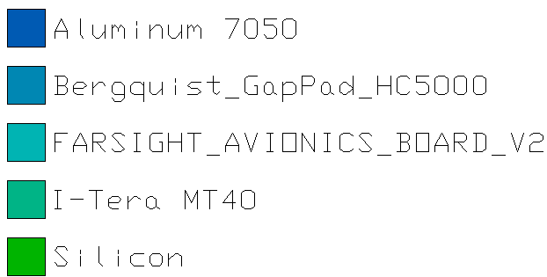
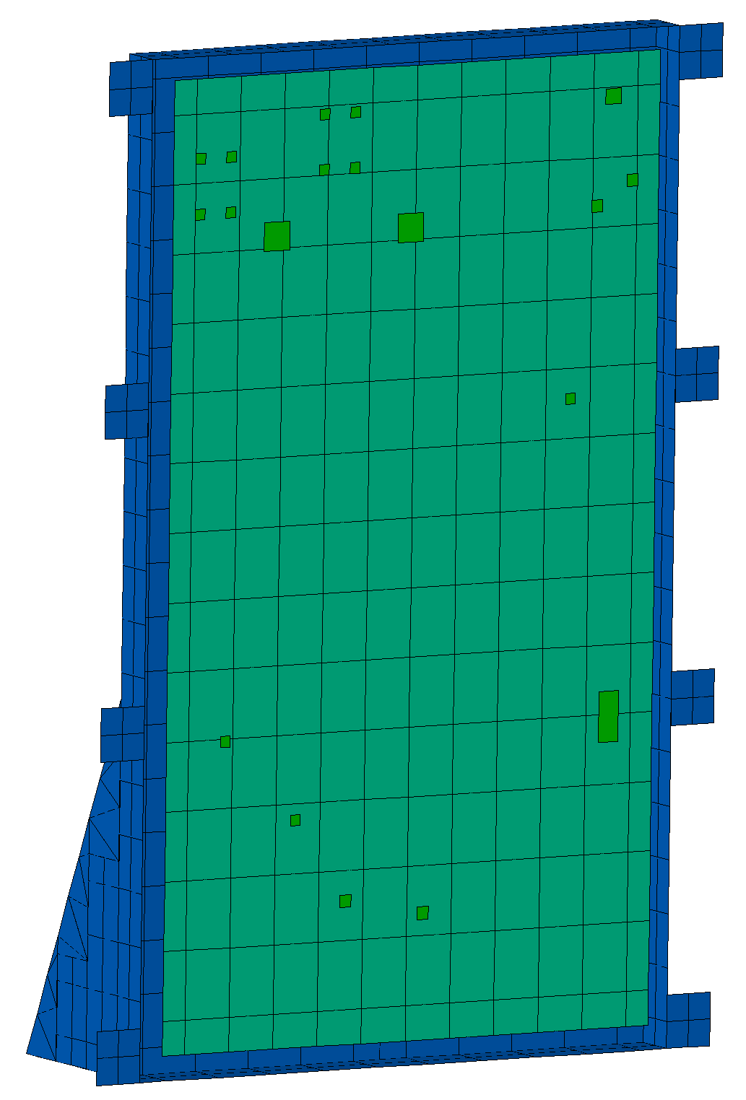
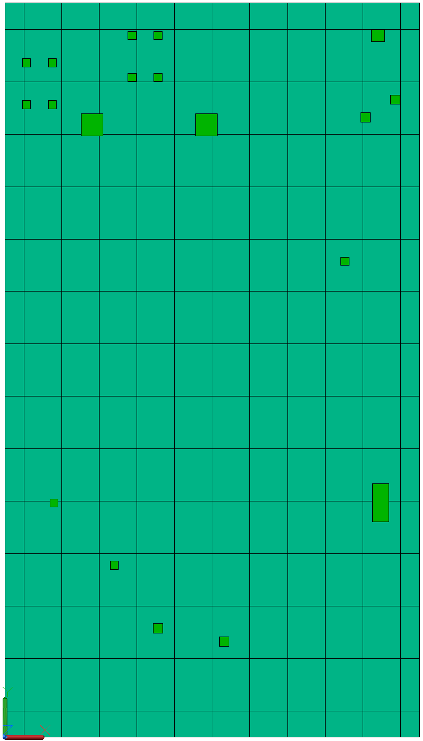
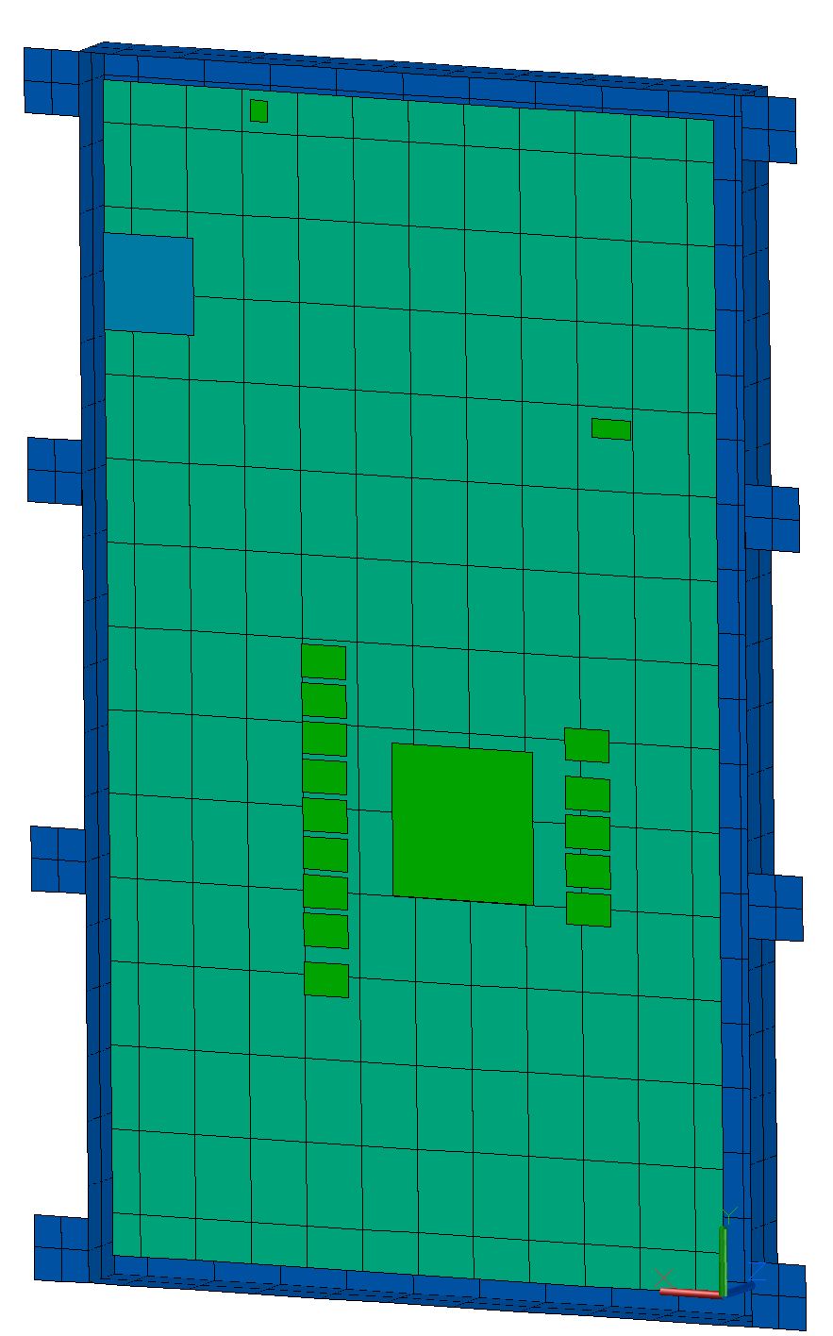
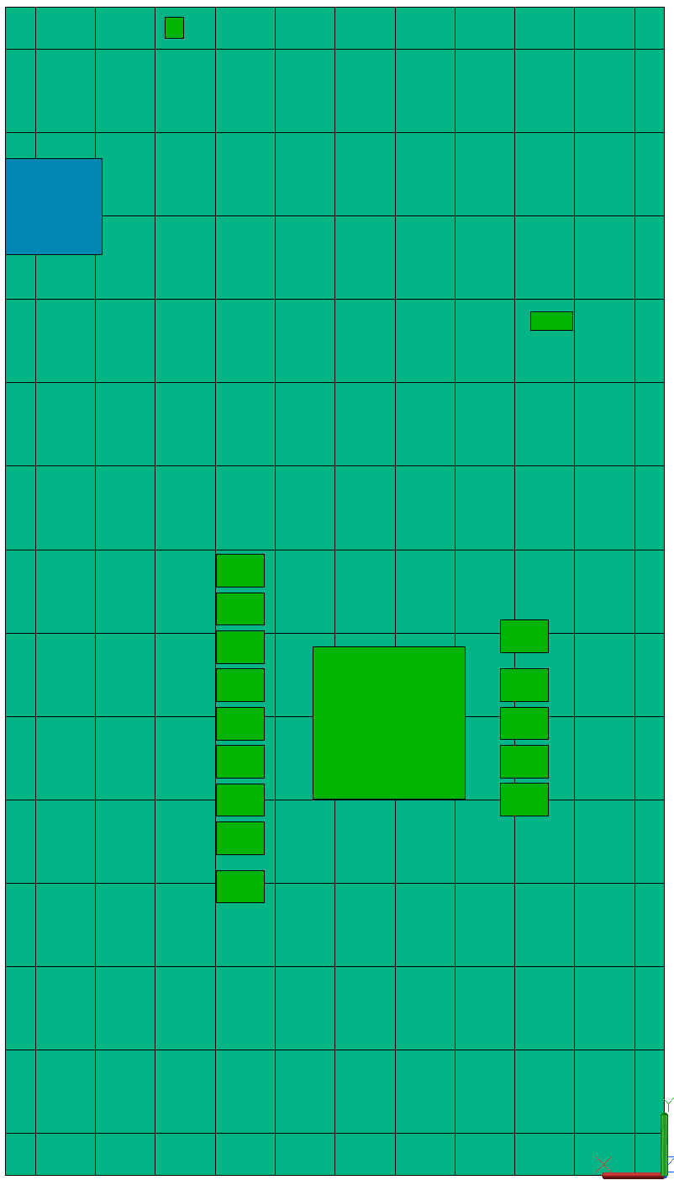
Thermophysical Properties
All housing is Aluminum 7050
Components are modeled as arithmetic node junctions, so material is irrelevant
Top Housing Hidden
PCB Top
Bottom Housing Hidden
PCB Bottom

Slide 6
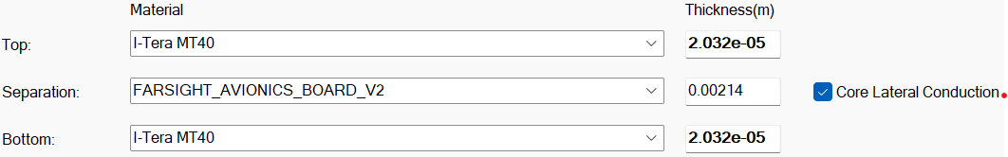
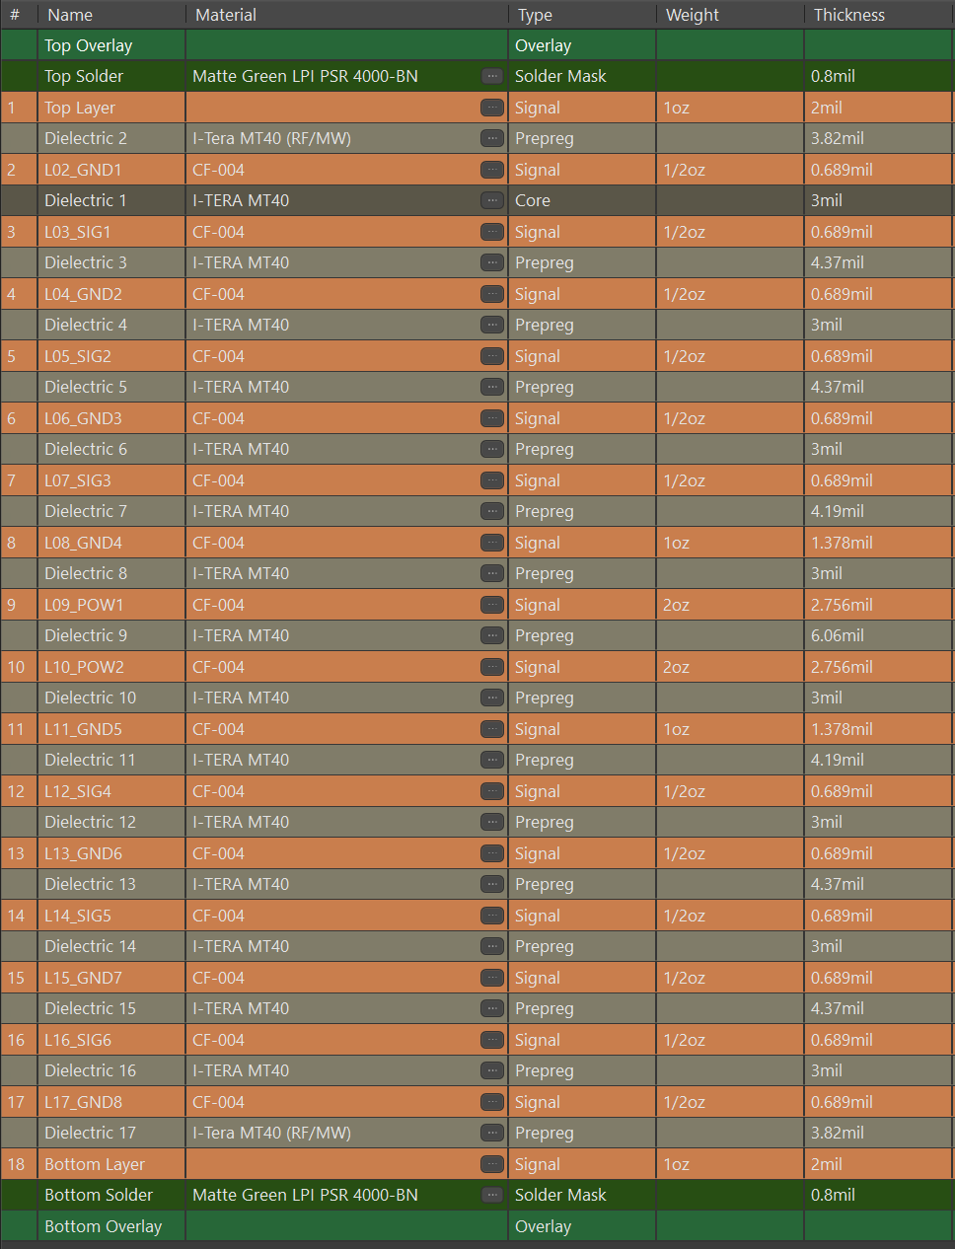
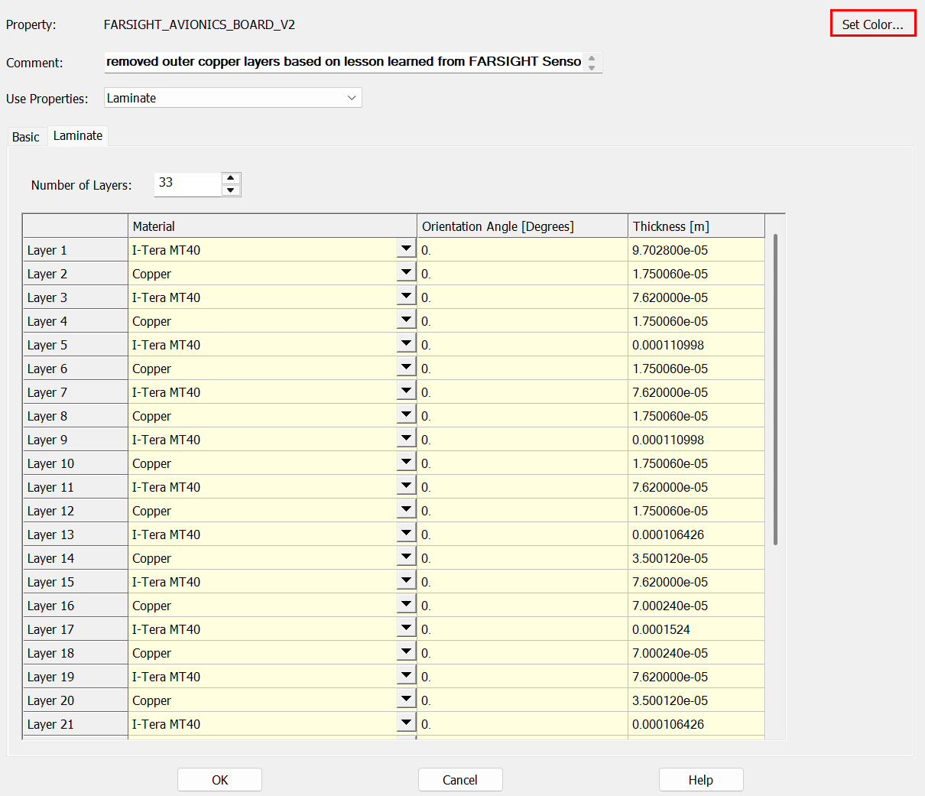
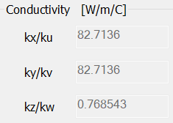
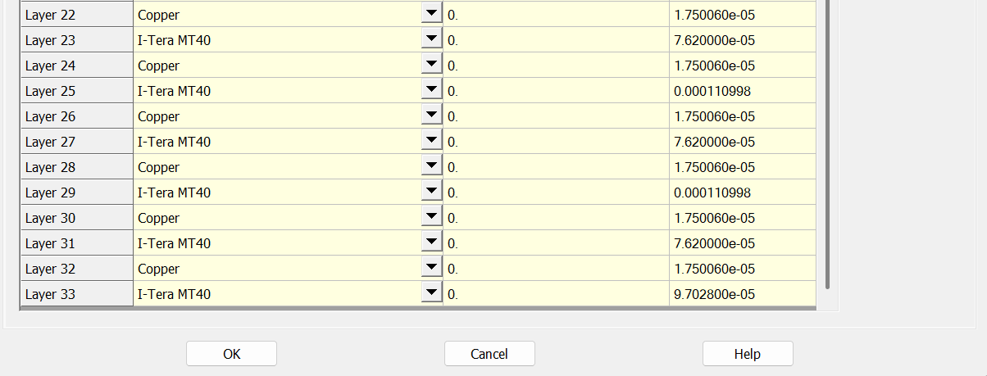
Thermophysical Properties: PCB Stackup
PCB stackup in Thermal Desktop follows the stackup provided by EE. Outer copper layers are neglected for conservatism (reduces thermal conductivity)
Density multiplier of 0.29 applied in Thermal Desktop to match the CAD-prescribed board mass of 88.82 g
Z is the through-thickness axis

Slide 7
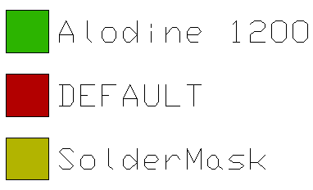
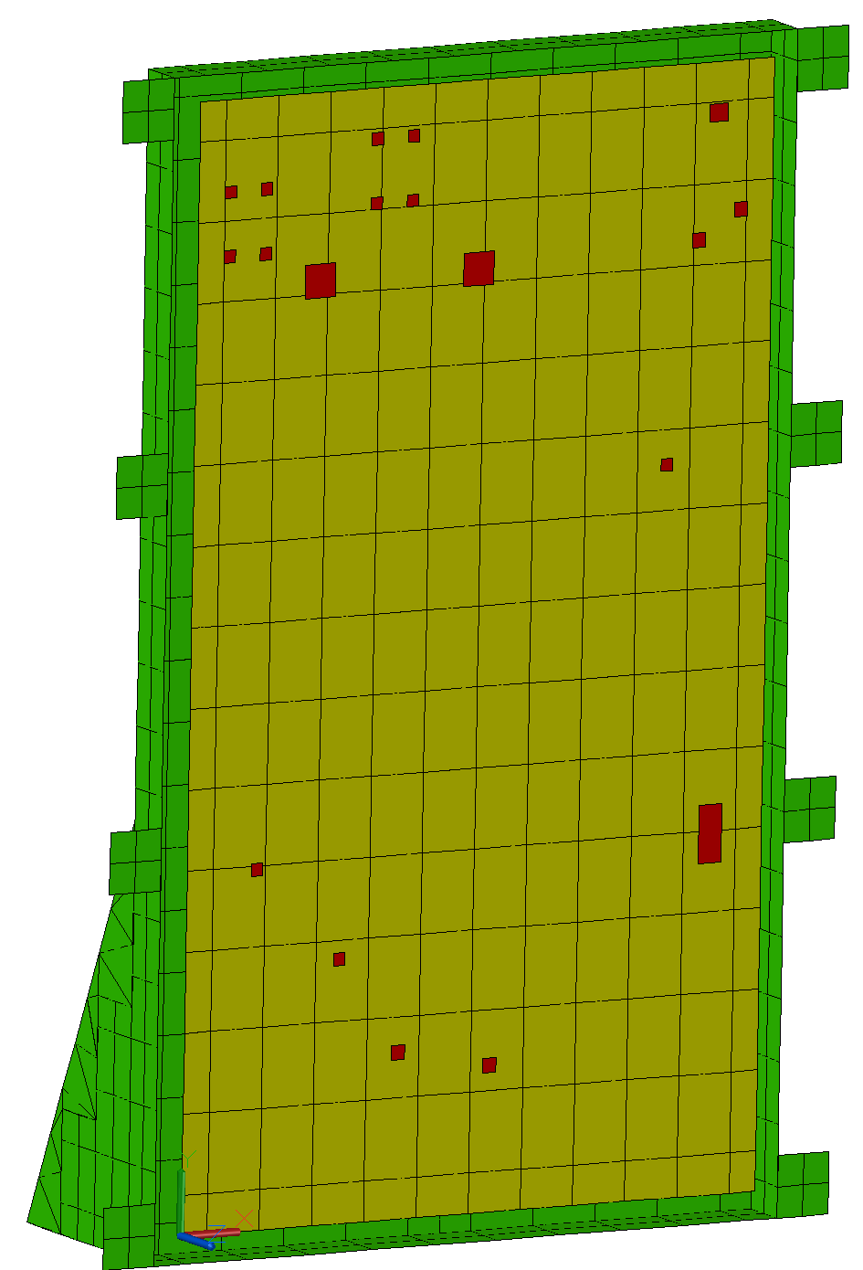
Optical Properties
All housing surfaces are assigned as Alodine 1200
Component junctions are not included in radiation, so their optical properties are left as DEFAULT

Slide 8

Heat Loads, Thermal Resistances, and Temperature Limits
PCB Top and PCB Bottom heat loads are the summed contributions of components not explicitly modeled, but with locations/details specified by EE
Spread Across Board heat load was specified by EE, and is split evenly between the top and bottom PCB surfaces
Red-highlighted $θ_{JB}$ values are estimates, interpolated based on the $θ_{JB}$ vs $θ_{JA}$ relationship for components where both values were available
Component Designator / Heat Load Location | Theta-JB (°C/W) | Theta-JC (°C/W) | Theta-JA (°C/W) | Low Limit (°C) | High Limit (°C) | Quantity | Heat Load (Per Component) [W]
U1 | 1.87 | 0.293 |  | -55 | 125 | 1 | 3.12
U5, U6, U7, U8, U9, U10, U11, U12, U13, U14, U15, U16, U17, U18 | 12.8 | 5.4 |  | -40 | 105 | 14 | 0.2
U3, U4 | 5.6 | - | 26.6 | -55 | 125 | 2 | 0.34
U96 | 10.5 | - | 35 | -40 | 125 | 1 | 1.058
U85 | 14.4 | 64.8 | 47.2 | -40 | 125 | 1 | 0.256
U38 | 6.8 | 12.4 | 23.7 | -55 | 125 | 1 | 0.241
U19 | 10.5 | - | 35 | -40 | 125 | 1 | 0.228
Q1 | 18.5 | 1.7 | 60 | -55 | 100 | 1 | 0.8
Q2 | 18.5 | 1.7 | 60 | -55 | 100 | 1 | 0.8
U76 | 10.5 | - | 35 | -40 | 125 | 1 | 0.0305
U77 | 10.5 | - | 35 | -40 | 125 | 1 | 0.009
U80 | 10.5 | - | 35 | -40 | 125 | 1 | 0.188
U43 | 10.5 | - | 35 | -40 | 125 | 1 | 0.09
U45 | 10.5 | - | 35 | -40 | 125 | 1 | 0.028
U47 | 10.5 | - | 35 | -40 | 125 | 1 | 0.077
U49 | 10.5 | - | 35 | -40 | 125 | 1 | 0.052
U44 | 10.5 | - | 35 | -40 | 125 | 1 | 0.089
U46 | 10.5 | - | 35 | -40 | 125 | 1 | 0.028
U48 | 10.5 | - | 35 | -40 | 125 | 1 | 0.0774
U50 | 10.5 | - | 35 | -40 | 125 | 1 | 0.052
U86 | 14.4 | 64.8 | 47.2 | -40 | 125 | 1 | 0.157
U81, U83 | 9.3 | 23 | 29.7 | -40 | 125 | 1 | 0.17
Q9,Q10 | 20.2 | 1.8 | 65 | -55 | 175 | 2 | 0.07
PCB Top | - | - | - | - | - | 1 | 0.6047
PCB Bottom | - | - | - | - | - | 1 | 0.095
Spread Across Board | - | - | - | - | - | 1 | 1.1294
 |  |  |  |  |  | SUM | 13

Slide 9
Contactors
Note: for contactors including multiple from objects (i.e. U5-U18 to PCB Bottom), the tabulated conductance value is overall conductance (not conductance per component)
From | To | Via | Conductance [W/C]
PCB Bottom (opposite Q1/Q2) | Bottom Housing | Gap Pad | 1.243
U1 | Bottom Housing | 1/Θ_JC and Gap Pad (series) | 0.191
U14-U18 | Bottom Housing | 1/Θ_JC and Gap Pad (series) | 0.470
U5-U13 | Bottom Housing | 1/Θ_JC and Gap Pad (series) | 0.847
PCB | Bottom Housing | 15 #4-40 Fasteners | 3.900
Top Housing | Bottom Housing | 8 #6-32 Fasteners | 3.360
Bottom Housing | Boundary (Mounting Panel) | 4 QTR-28 Fasteners + Gap Pad (parallel) | 17.585
Q9 | PCB Bottom | 1/Θ_JB | 0.050
U1 | PCB Bottom | 1/Θ_JB | 0.535
U5-U18 | PCB Bottom | 1/Θ_JB | 1.094
U81 | PCB Bottom | 1/Θ_JB | 0.108
Q10 | PCB Top | 1/Θ_JB | 0.050
Q1 | PCB Top | 1/Θ_JB | 0.054
Q2 | PCB Top | 1/Θ_JB | 0.054
U19 | PCB Top | 1/Θ_JB | 0.095
U3-U4 | PCB Top | 1/Θ_JB | 0.357
U38 | PCB Top | 1/Θ_JB | 0.147
U43, U45, U47, U49 | PCB Top | 1/Θ_JB | 0.381
U44, U46, U48, U50 | PCB Top | 1/Θ_JB | 0.381
U80 | PCB Top | 1/Θ_JB | 0.095
U85 | PCB Top | 1/Θ_JB | 0.069
U86 | PCB Top | 1/Θ_JB | 0.069
U96 | PCB Top | 1/Θ_JB | 0.095

Slide 10
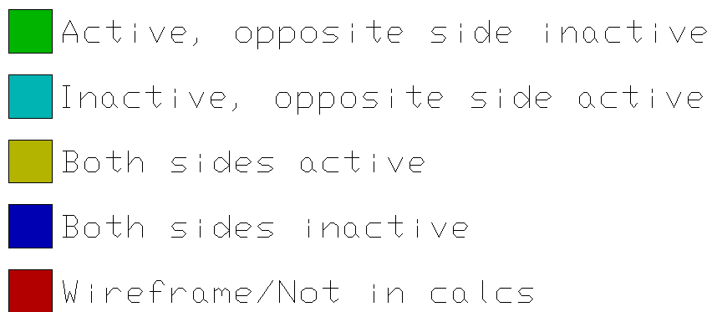
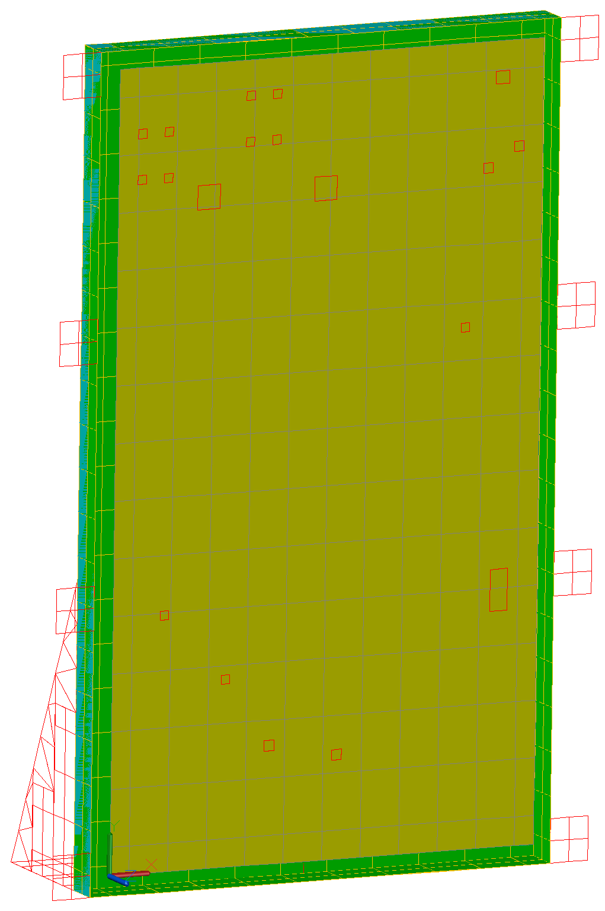
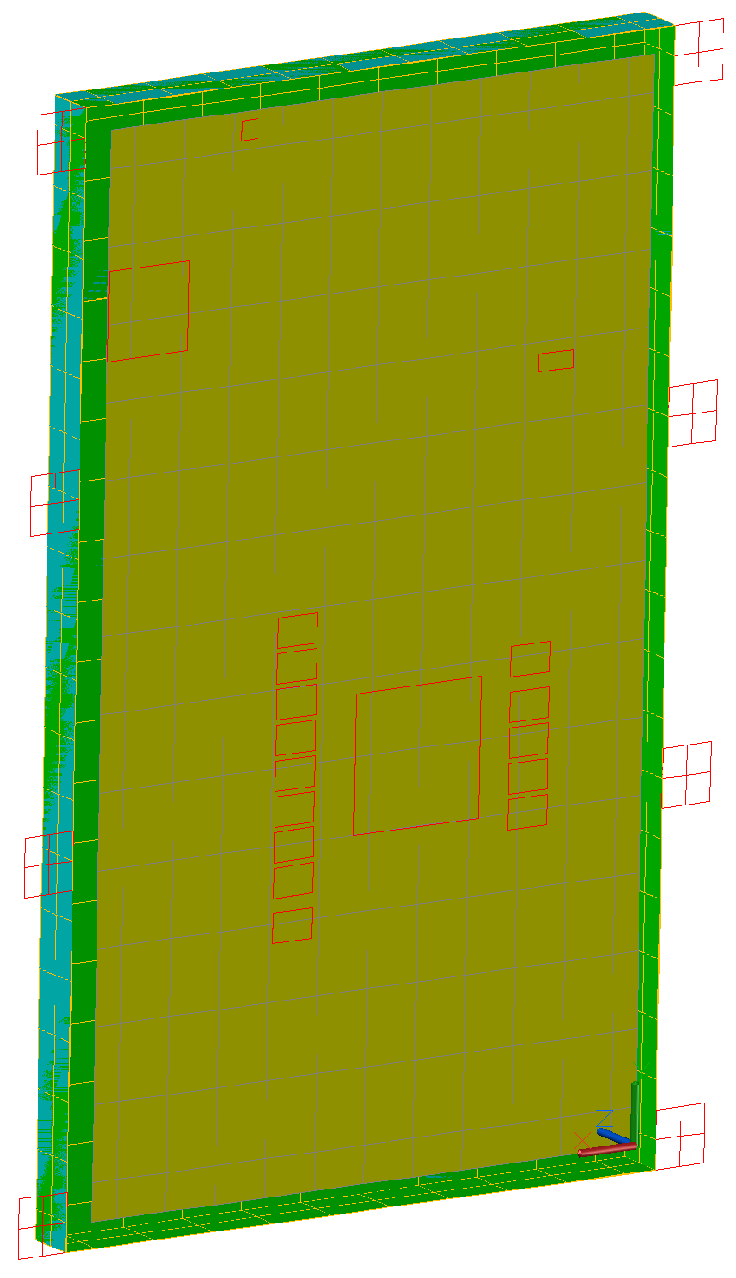
Radiation Analysis Group
Only internal radiation is modeled between the internal housing surfaces and the PCB (board)
  External radiation neglected – conservative for the hot case
  Component junctions neglected from internal radiation – conservative for the hot case
Top Housing Hidden
Bottom Housing Hidden

Slide 11
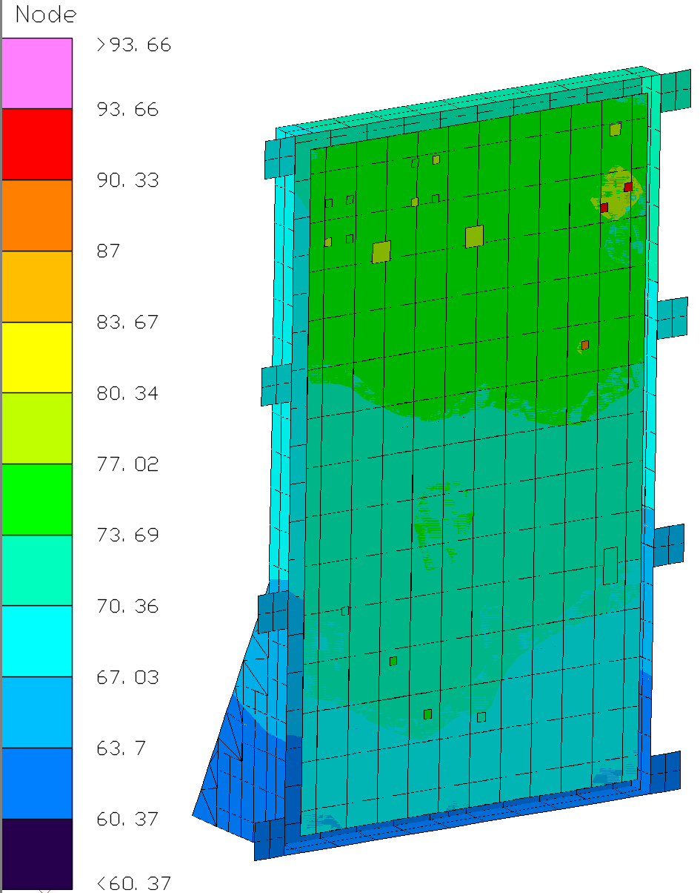
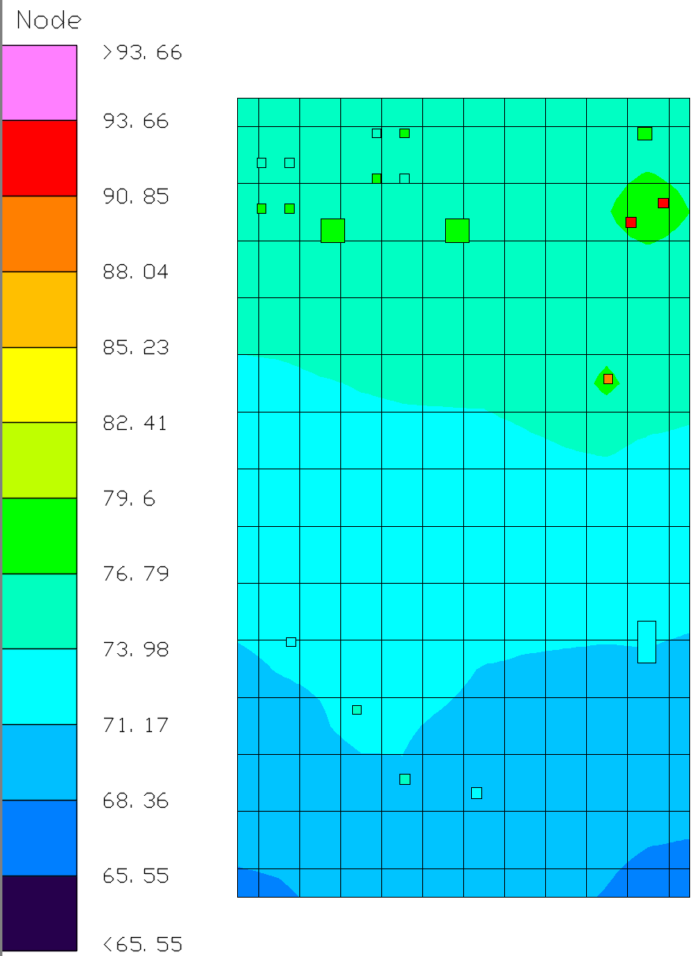
Results
The module was analyzed to steady-state assuming a mounting panel hot temperature of 60°C
Q1 is the limiting component, with a hot temperature predict of 93.66°C and a maximum temperature of 100°C
  Accounting for 5°C thermal uncertainty, the minimum margin is 1.34°C

Slide 12
Summary
The Farsight Avionics Module was analyzed and has positive margin for all components for a mounting panel temperature of 60°C
  5°C uncertainty margin in combination with conservative assumptions (neglection of junction and external radiation) provide confidence that the module can operate up to 60°C
  The Q1 component was identified as the temperature-limiting component, with 1.34°C margin to its maximum operating temperature of 100°C
The least extreme minimum operating temperature limit for the modeled components is -40°C. Cold case results are not presented as they are trivial – when operating, component temperatures will always be hotter than the cold case mounting panel temperature. Unless the entire module has a starting temperature less than -40°C, module operability is not a concern

Slide 13
Model Updates for 9/29 Design Closure

Slide 14
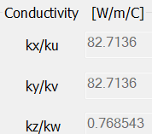
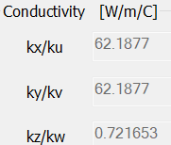
Model Changes
Testing by German confirmed overall board heat load of ~13 W
Heat loads:
  Overall: 13 W → 14.52 W (+11.7%)
    +30% to power dissipations for:
      U1, U85, U65, U76, U79, U86 (summed: 3.66 W to 4.76 W)
    +20% to spread across board heat load
    Limiting components Q1/Q2:
      Q1: 0.8 W → 0.45 W
      Q2: 0.8 W → 1.3 W
Board properties:
  6 copper layers now modeled as I-TERA MT40
    Reduced board thermal conductivity
Q1/Q2 connection to board:
  ThetaJB reduced from assumed 18.5 C/W to datasheet ThetaJC value of 1.7 C/W

Slide 15
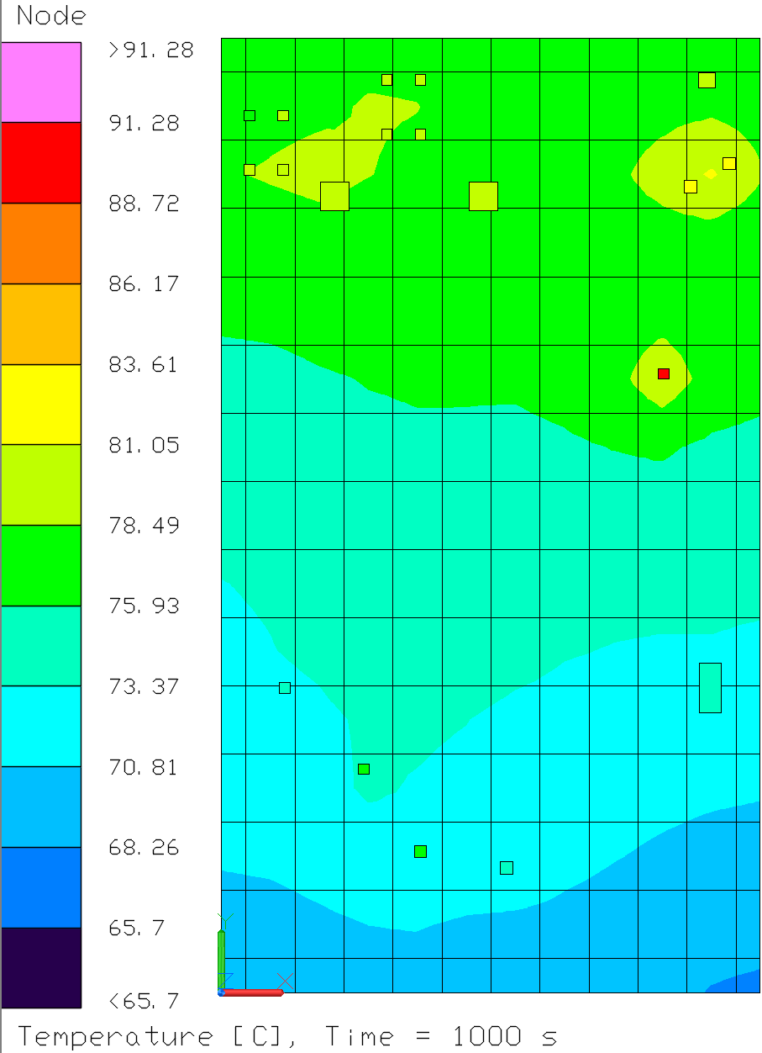
Updated Results
Design closes with positive margin for all components up to a 60°C mounting temperature
Component Q2 is the limiting component, with the minimum margin to its maximum junction temperature of 100°C
  Maximum temperature predict: 83.2°C
  Maximum predicted temperature (+ 5°C thermal uncertainty margin): 88.2°C
  Margin to maximum junction temperature of 100°C: +11.8°C

Slide 16
Conclusion
Primary thermal concerns assuaged by testing confirmation of ~13 W overall power dissipation
Updated heat loads and board properties based on input from EE make the module overall hotter. However, limiting component (Q1/Q2) temperatures decreased due to less conservative contact to board, so minimum margin has increased
FARSIGHT Avionics Module design closes with positive margin – no enclosure modifications are necessary

Slide 17
Model Updates for 4/7/2026 Design Closure

Slide 18
Model Changes
Testing by German confirmed overall board heat load of ~14.93W
Heat loads:
  Overall: 14.52 W → 14.93 W (+2.8%)
  Added U75: 0.257W
  U81 UPDATED POWER FROM 0.17W to 0.324W
Board properties:
  According to German Goncharuk, minor change on the PCB board, no need to modify the thermal conductivity of the board.
U95 location changed:
  U95 location changed, no action since this is not modeled in TD, heat loads applied in PCB distributed.

Slide 19
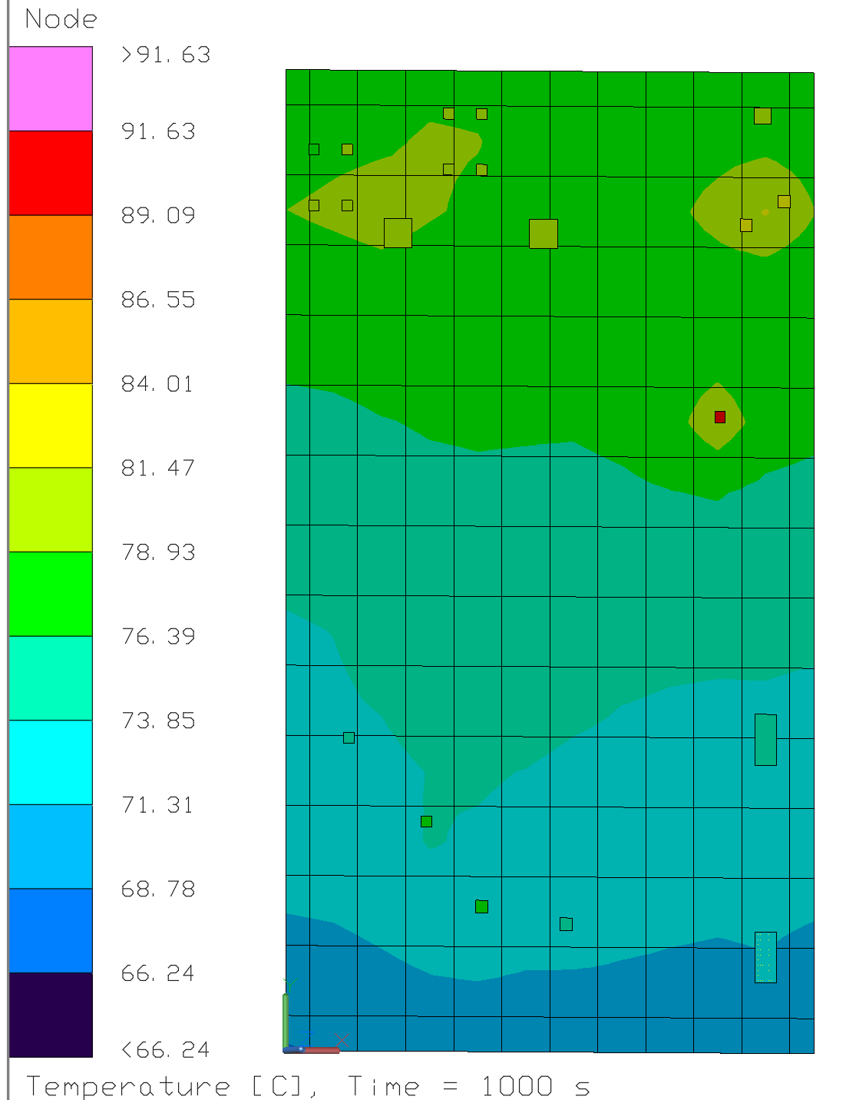
Updated Results
Design closes with positive margin for all components up to a 60°C mounting temperature
Component Q2 is the limiting component, with the minimum margin to its maximum junction temperature of 100°C
  Maximum temperature predict: 83.5°C
  Maximum predicted temperature (+ 5°C thermal uncertainty margin): 88.5°C
  Margin to maximum junction temperature of 100°C: +11.5°C

Slide 20
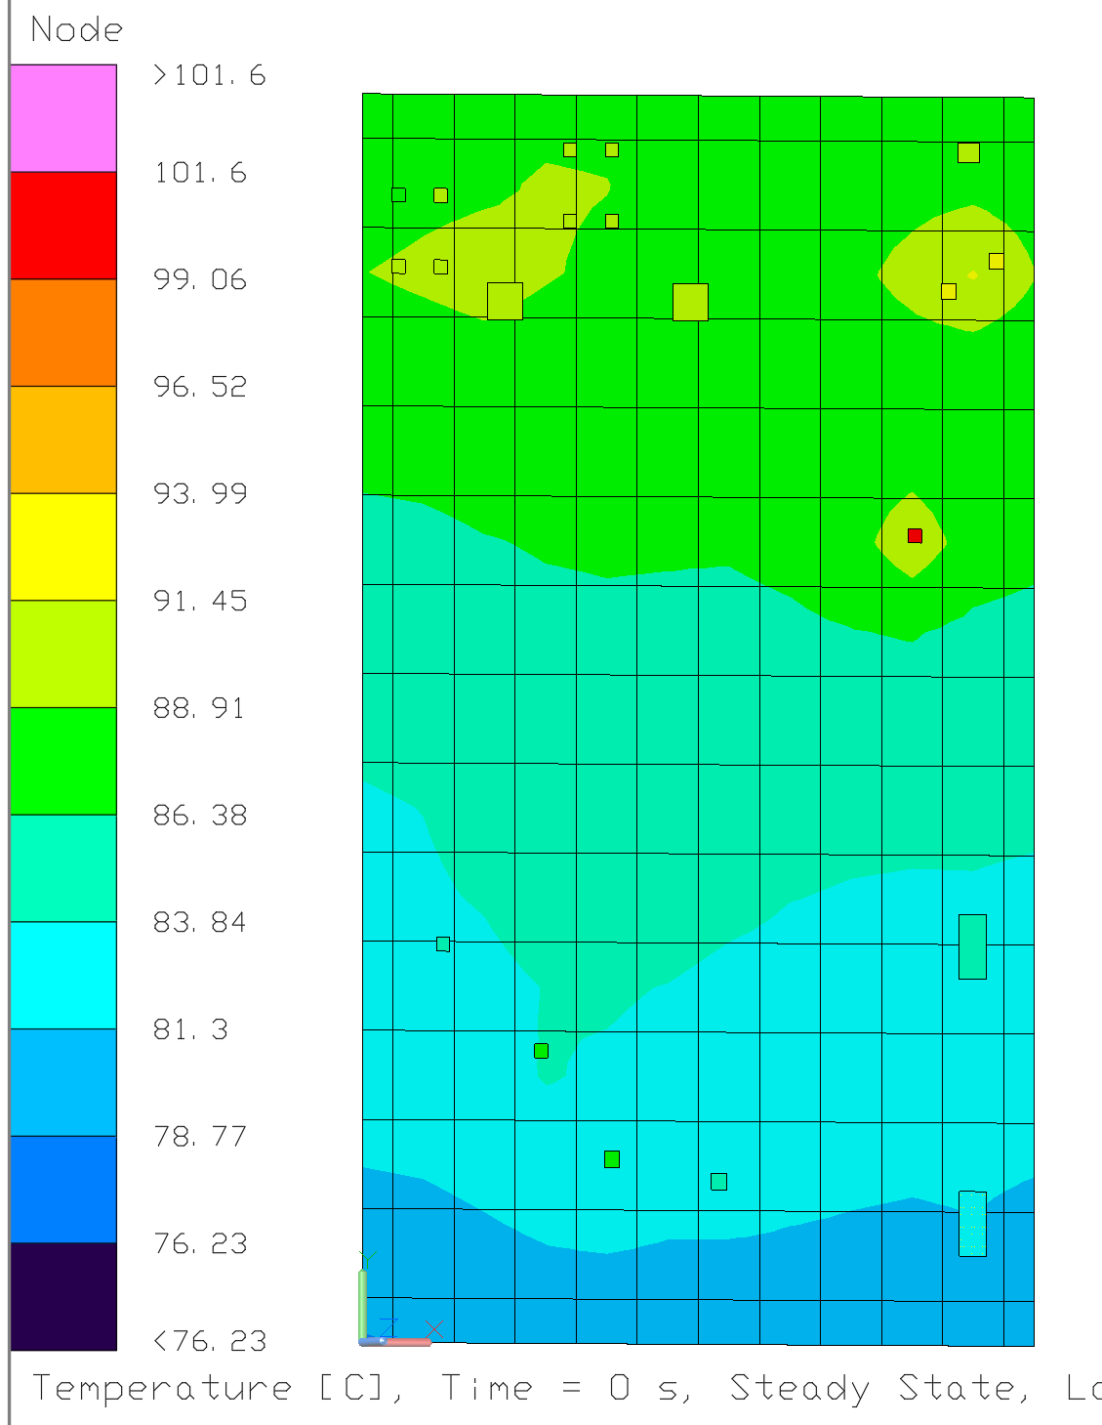
Updated Results
Design closes with positive margin for all components up to a 70°C mounting temperature
Component Q2 is the limiting component, with the minimum margin to its maximum junction temperature of 100°C
  Maximum temperature predict: 93.5°C
  Maximum predicted temperature (+ 5°C thermal uncertainty margin): 98.5°C
  Margin to maximum junction temperature of 100°C: +1.5°C

Slide 21
Conclusion
Primary thermal concerns assuaged by testing confirmation of ~14.93 W overall power dissipation
A trade of study was performed under 70 °C boundary condition, the margin for critical unit dropped from 11.5 °C to 1.5°C, which the unit still able to maintain its temperature within the operation temperature limits. Able to bring up the operation limits of farsight avionics module to 70 °C if necessary.
FARSIGHT Avionics Module design closes with positive margin – no enclosure modifications are necessary

